Slide 1
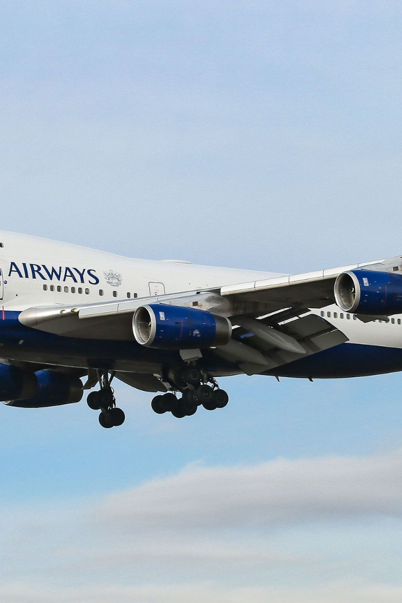

British Airways Customer Feedback Analysis
In this analysis, we present insights and key findings from our study of customer feedback on British Airways. Through topic modeling, sentiment analysis, and a word cloud, we were able to identify the main areas of concern for customers.
by Karri Dharma Teja

Slide 2
Flight Experience & Service Quality
Crew Courtesy ✈️
Inflight Amenities 🛋️
Positive comments on crew members being courteous.
Comments on cabin ambience and in-flight amenities.
Food Quality 🍲
Entertainment 🎬
Mixed feedback on food quality, with some recommending improvements.
Entertainment options appreciated, but some requests for more variety.

Slide 3
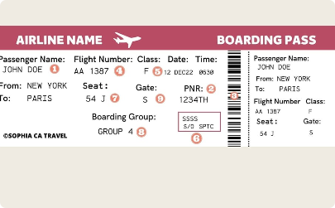
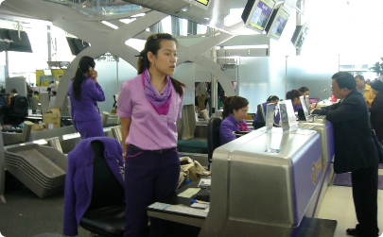
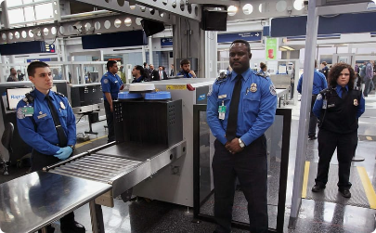
Booking & Reservations
Online Booking Tools 💻
Assistance at the Counter ✅
Security Checks 🔍
Comments on efficiency and clarity of security checks at the airport.
Suggestions to improve online booking process for convenience.
Feedback on helpfulness of staff at the counter during check-in and related processes.

Slide 4
Cabin Comfort & Amenities
1
Seat Configuration 🪑
Feedback on the comfort of various seat configurations and types.
2
Temperature Control ❄️
Comments on temperature control and ventilation in the cabin.
3
Cleanliness 🧹
Observations on cleanliness, hygiene and sanitation measures.

Slide 5

Customer Support & Communication
1
Quick Response Time 🕒
2
Staff Knowledge 🎓
Feedback on staff knowledge and their ability to address specific questions or concerns.
Appreciation for quick response times and prompt resolution of customer queries.
3
Phone Support 📱
Comments on availability and quality of phone support for customers.

Slide 6
Delays & Inconvenience
Baggage Handling 💼
Comments on delays in baggage handling and promptness of resolution for lost or damaged baggage.
1
2
3
Cancelled Flights ❌
Flight Rescheduling 🔄
Feedback on handling of cancelled flights and compensation mechanisms.
Observations on rescheduling of flights and processes for communicating with passengers.

Slide 7
Recommendations
Enhance Service Quality ✅
Streamline Booking Process 🔍
Customer-Centric Approach 🤝
Timely Communication ⏰
Address specific topics highlighted in feedback to enhance customer satisfaction.
Optimize reservation processes to minimize customer frustrations and ensure smooth bookings.
Strengthen customer support to address concerns and inquiries promptly, ensuring a positive customer experience.
Improve communication during delays and disruptions, keeping passengers informed and minimizing inconvenience.

Slide 8
Impact and Next Steps
Enhanced Customer Satisfaction 😃
Positive Brand Perception 🤩
Continuous Monitoring and Improvement 📊
Implementing recommendations can positively impact customer satisfaction and loyalty.
Addressing feedback can help improve overall perception of the brand among customers.
Continuous monitoring and analysis can provide insights for ongoing improvements and decision-making.

Slide 9

Thank You!
Thank you for your attention to our analysis of customer feedback on British Airways. For a more detailed analysis, please refer to the complete report.
We hope our insights prove useful in making decisions to improve customer satisfaction and loyalty.

